Slide 1
Uses for ConTeXt in an office environment
Case study, K-Patents Oy

Slide 2
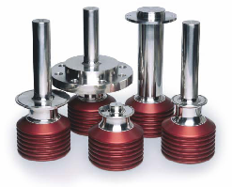
K-Patents Oy
Founded 1978, now with 45 sales reps all over the world
Headquarters in Vantaa, Finland, with 20 (+4) employees
Manufactures instru- ments for measuring concentration inline in process industry

Slide 3
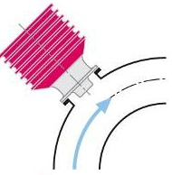
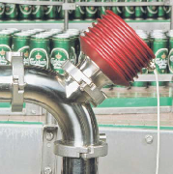
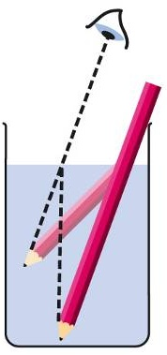
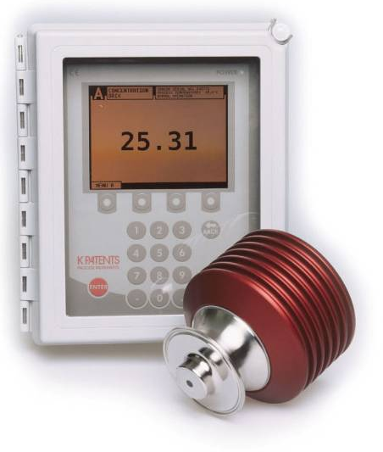
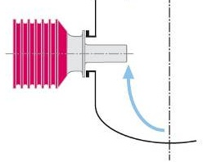
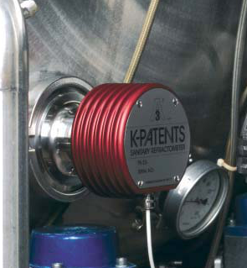
Digital inline process refractometer
Refractive Index n_{D} measurement principle
Inline process refractometer
Refracto- meter system

Slide 4
Our computers
Old std: Windows XP + Office2003
New std: Windows 7 + Office2007
Specialised software
Layout, pdf tweaking
Graphics (vector drawings, bitmaps)
2D & 3D designing, card wiring design
Documentation

Slide 5
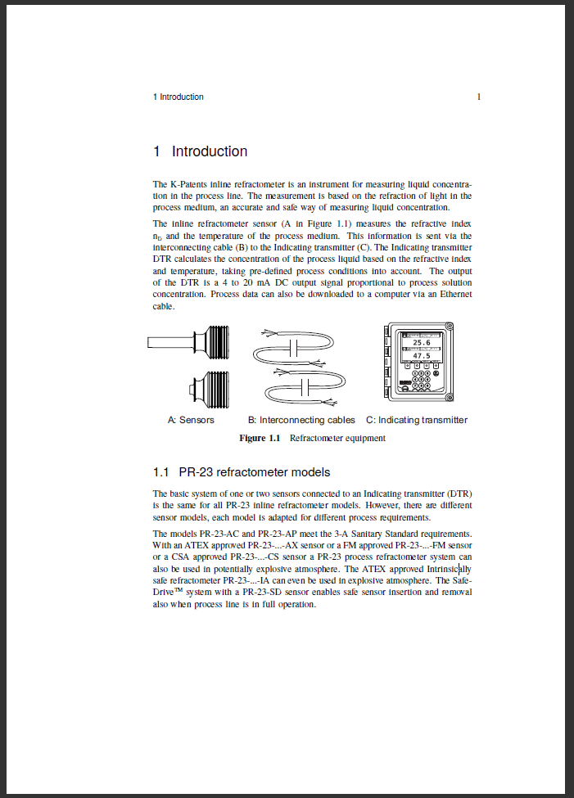
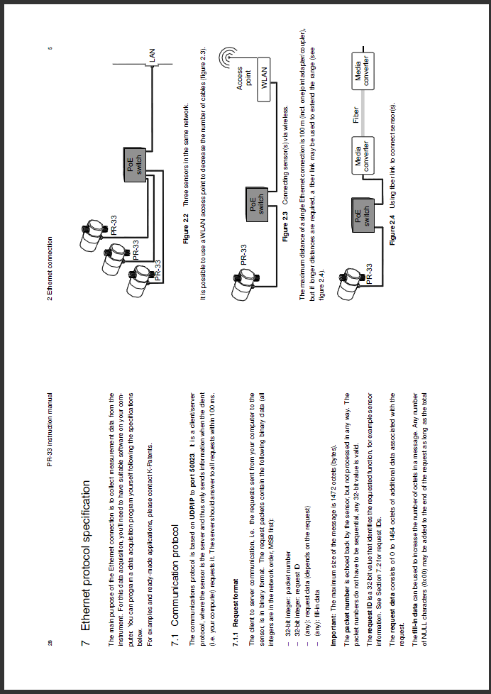
ConTeXt @ K-Patents since 2002
Manual for PR-23
A4 softback book, 150 p.
Manual for PR-33-S
A5 booklet, 40 pages

Slide 6
ConTeXting our user manuals
Reasons to migrate from Word
Graphic-heavy document unwieldy
Linking crashes, embedding bloats
Consistency hard to maintain
Handling vector graphics
Other options considered
LaTeX; visuals difficult to control
FrameMaker; too big and costly

Slide 7
Advantages of ConTeXt
System independence
Versatility
Vector graphic/pdf input
Separating text and graphics as well as content and layout
Linking to graphics
Handling a multilingual environment

Slide 8
Challenges with ConTeXt
Initial setup, getting started
Small user base, little documentation
Very few Windows users at the time
Potential translators
”Can you send it to us in Word?”
Updating/upgrading a hassle
When from MKII to MKIV?
”If it ain’t broke, don’t fix it”

Slide 9
Unexpexted bonuses
Imposition: (re)arranging pdf files
Technical writing in general
White papers
Other documentation
SciTe as html editor
ConTeXt augments our collection of tools.

Slide 10
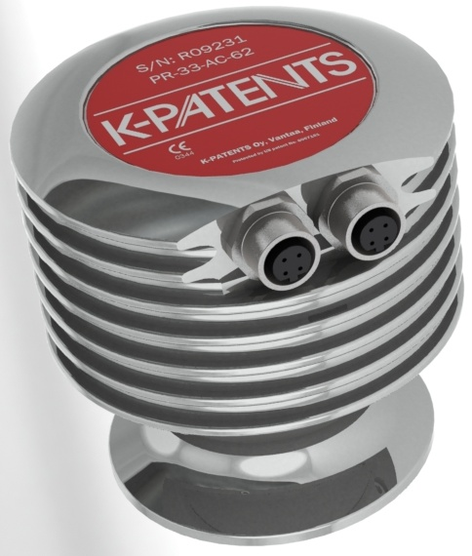
Future ConTeXting
PR-33-AC: PDF manual shipped as file in the instrument (on a "mini web server")
Adding interactivity
More technical docs?
Other uses?

Slide 11
Links
ConTeXted (excl. covers) manuals
The first A4 manual (delivered in a binder): http://www.kpatents.com/pdf/downloads/pr-03.pdf
The insides of an A4 softback: http://www.kpatents.com/pdf/downloads/pr-23.pdf
An 'accessory' manual, for binder: http://www.kpatents.com/pdf/downloads/dd-23.pdf
A5 booklet file (A4 paper) for the semicon instrument: http://www.kpatents.com/pdf/downloads/pr-33-s_booklet.pdf
A5 file for the semicon instrument: http://www.kpatents.com/pdf/downloads/pr-33-s.pdf
Homepage: http://www.kpatents.com/
Measurement principle: http://www.kpatents.com/pdf/downloads/tcn_1-00-05_refractive_index_principle.pdf
Demo unit online: http://demo.kpatents.net/

