Slide 1
A Different Philosophy
How to introduce non-nerds to the world of ConTeXt

Slide 2
starting point
Students familiar with standard word processing software (MS Office, Open Office, Pages...)
ConTeXt is installed and ready-to-use
Students have a reason to learn ConTeXt
Academic dissertations, reports, etc.
Maths or linguistic layout challenges
Interest in layout and typography

Slide 3
Structural thinking
How it should be done...
Real Life™
Introduction
My research is centered on how computers are named in office and university networks. The naming is almost always goverened by strict rules, but they can vary from schematic to imaginative and the motivation behind the rules can vary from the network administrator’s personal preferences and interests – or comfort – to security aspects or the institution’s main field of activity.
Here we go, that’s the first chapter heading...
I’ll make that bigger and bold and I’ll add an empty line below...

Slide 4
From concrete to abstract
What you see is what you (hope to) get
wHat you describe is what you get
Introduction
My research is centered on how computers are named in office and university networks. The naming is almost always goverened by strict rules, but they can vary from schematic to imaginative and the motivation behind the rules can vary from the network administrator’s personal preferences and interests – or comfort – to security aspects or the institution’s main field of activity.
\setuphead
[chapter]
[style=\sstfc]
\setupwhitespace[medium]
\starttext
\chapter{Introduction}
My research is centered on how computers are named in office and university networks. The naming is almost always goverened by strict rules, but they can vary from schematic to imaginative and the motivation behind the rules can vary from the network administrator’s personal preferences and interests – or comfort – to security aspects or the institution’s main field of activity.
\stoptext

Slide 5
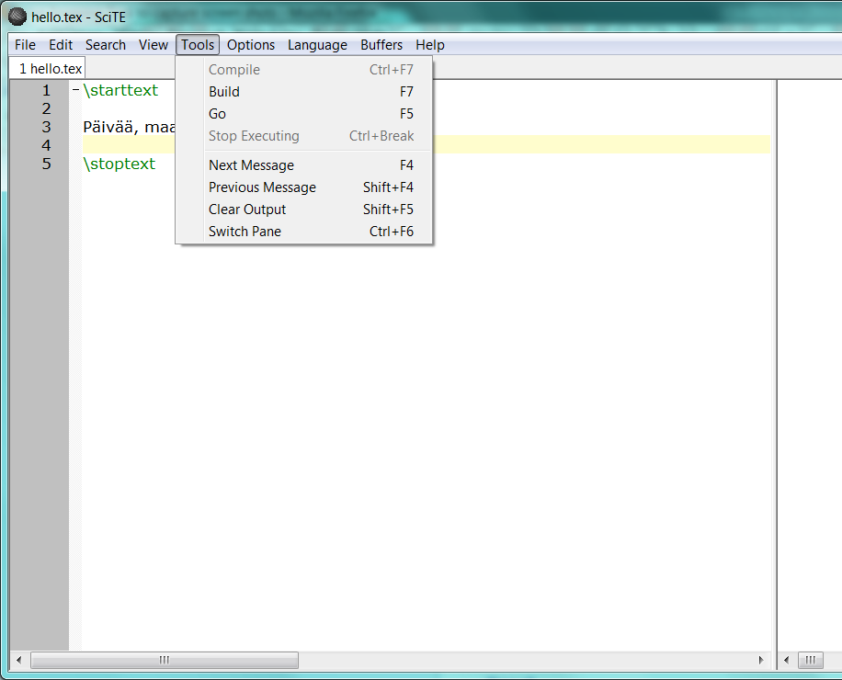
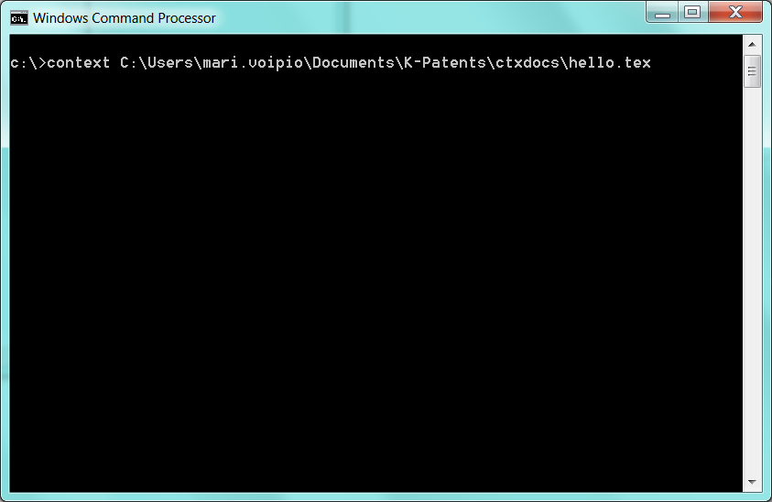
There are 10 types of people
Clickers
typers

Slide 6
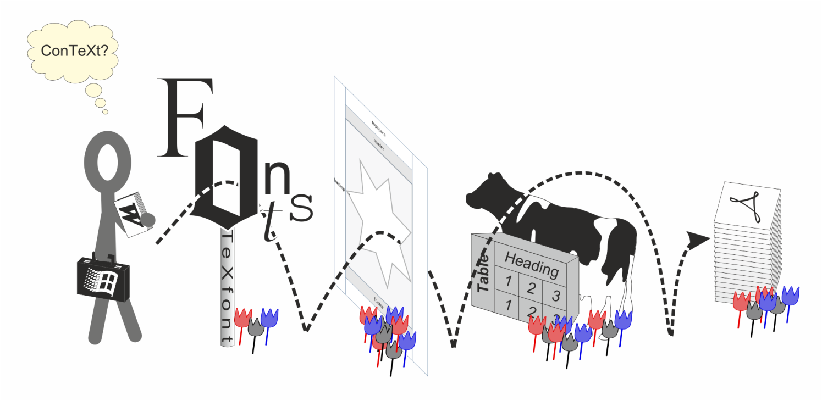
Hoops to jump

Slide 7
easing into context, step 1
Start from solid base
Structural thinking
Separate content and layout
Learn to use your editor
Highlight
Autocomplete
Check before running
And why not make it neat while you are at it?

Slide 8
easing into context, step 2
Solving font problems
Encoding/regimes
Visual catalogue for basic font families
Basic style sheets = modules

Slide 9
Easing into context, step 3
Not so marginal philosophy
Not from outside in but left to right and top down
What’s your internal measurement unit?
It’s floating in the air
Adding images: formats, sizes, placement
Expanding to other floats
Formatting captions
Unnatural thinking: tables

Slide 10
Easing into context, step 4
Debugging is a skill, too
Better little and often than a complete mess
You sure you checked the code?
Read and contemplate
A bit of pep talk
No need to get it right on the first go
The reward is in consistency
Shed your limitations and take flight!

