Slide 1
Observations on learning ConTeXt
And how to make it easier

Slide 2
Reasons to learn ConTeXt
Publishing
Exact control of the layout and visuals in general
Easy handling of large documents
Combining material from different sources
Interactive pdf, multiformat output
Academics
Structure, consistency, bibliography
Maths, chemistry, plotting (MetaPost)
Linguistics, non-Latin languages
Other
Just because it is something new and exciting

Slide 3
Learning strategies
“Fiddling around” – learn-by-doing
The Apple approach (a 3-year-old can use an iPad)
Not suitable for more abstract/specialised software
How did he do that? – learn-by-example (or imitation)
Learn-by-tweaking – sometimes called “stealing”
How do I do x? – learn-by-asking
Strictly “need-to-know” basis
Once in a while called “laziness”
RTFM – learn-by-reading
Theoretical, “want-to-know-everything” basis
Seldom appears in pure-bred form

Slide 4
Migrants
From LaTeX
ConTeXt allows easier control of the visuals
Understanding of the basic concepts
From WYSIWYG desktop publishing (InDesign, PageMaker)
Looking for automating workflows
Good grasp of the visual theory
Maybe not familiar with command line or descriptive tagging
From WYSIWYG word processing (MS Office, OpenOffice)
Need to handle large documents or maths or linguistics
Background can vary, shaky knowledge of the basic concepts
Not interested in the deeper workings

Slide 5
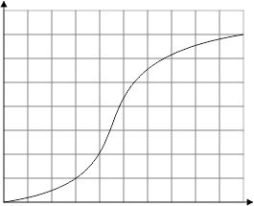
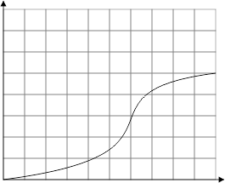
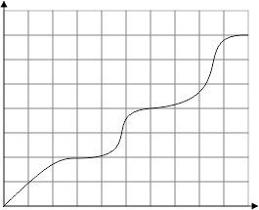
Learning process
Skill
Skill
Skill
Time
Time
Time
Theory
Word
ConTeXt?

Slide 6
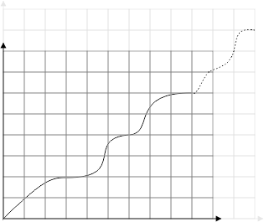
Learning process, revised
Skill
Skill
Skill
Time
Time
Time
Theory
Word
ConTeXt?

Slide 7
How to help?
Software usability
Ease of installation
Editor integration
context live @ contextgarden.net
Modules
Documentation
Cheat sheets for LaTeX users
Short manuals with a single recipe in each
Reference manual
The ConTeXt Community; wiki, mailing list, user meetings
Example files
“File per feature” enables easy debugging
Special sets for WYSIWYG migration?

